Slide 1
Object Oriented Programming
Major issues need to resolved
How to represent real-life entities
How to ensure reusability and extensibility of modules
How to develop modules that are tolerant to any changes in future
How to improve software productivity and decrease software cost
How to improve the quality of software  How to manage time schedules:

Slide 2
Software Evolution
To built today’s complex software it is just not enough to put together a sequence of programming statements and sets of procedures and modules; we need to incorporate sound construction techniques and program structures that are easy to comprehend, implement and modify.
Since the invention of the computer, many programming approaches have been tried.

Slide 3
Software Evolution
Such as Modular programming, top-down programming, bottom-up programming and structured programming.
The primary motivation in each case has been the concern to handle the increasing complexity of programs that are reliable and maintainable.

Slide 4
Procedure-Oriented Programming
Conventional programming using high level language such as COBOL, FORTRAN and C is commonly known as Procedure-oriented programming.
In the Procedure-oriented approach the problem is viewed as a sequence of things to be done such as reading, calculating and printing.
The primary focus is on functions.

Slide 5
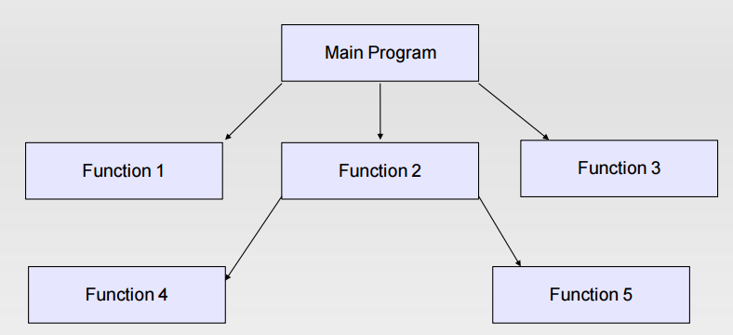
Procedure Oriented Programming

Slide 6
Procedure Oriented Programming
Procedure-oriented programming basically consists of writing a list of instructions for the computer to follow and organizing these instructions into groups known as functions.
We normally use a flowchart to organize these actions and represent the flow of control from one action to another
More importance to functions very little attention to data that are being used by the functions.

Slide 7
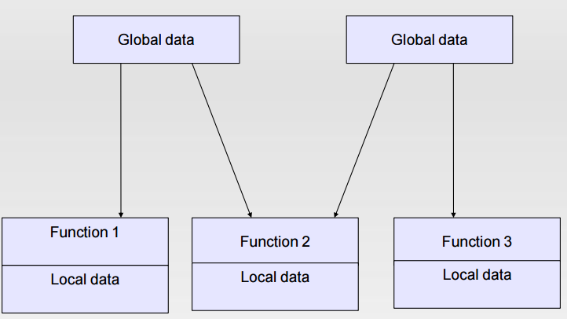
Procedure Oriented Programming

Slide 8
Procedure Oriented Programming
What happens to data? How are they affected by the functions that work on them?
In multi-function program many important data items are placed as global so that they may be accessed by all the functions. Each function may have its own local data.
In large program it is very difficult to identify what data is used by which function. In case we need to revise an external data structure we also need to revise all function that access it.

Slide 9
Object Oriented Programming
OOP treats data as a critical element in the program development and does not allow it to flow freely around the system.
It ties data more closely to the functions that operate on it, and protects it from accidental modification from outside functions.
OOP allows decomposition of a problem into a number of entitles called objects.

Slide 10
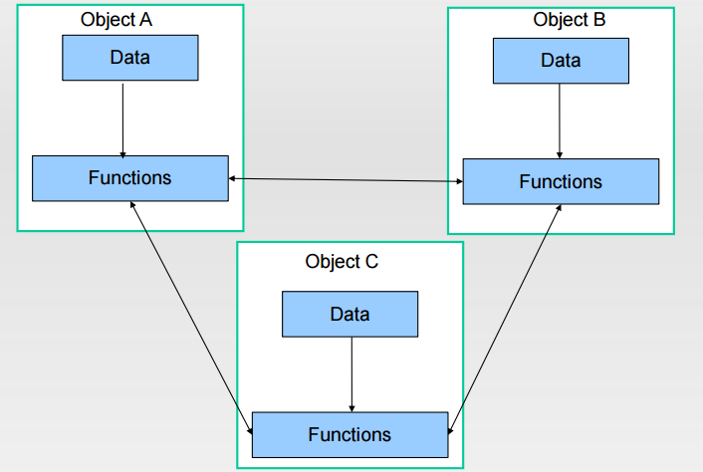
Object Oriented Programming

